Slide 1
COVID19 Timeline Analysis
File created on: 11/22/2021 8:48:19 AM

Slide 2
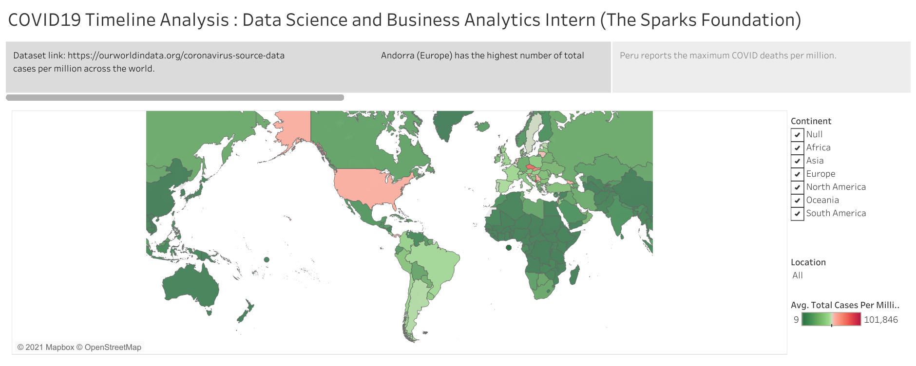

Slide 3
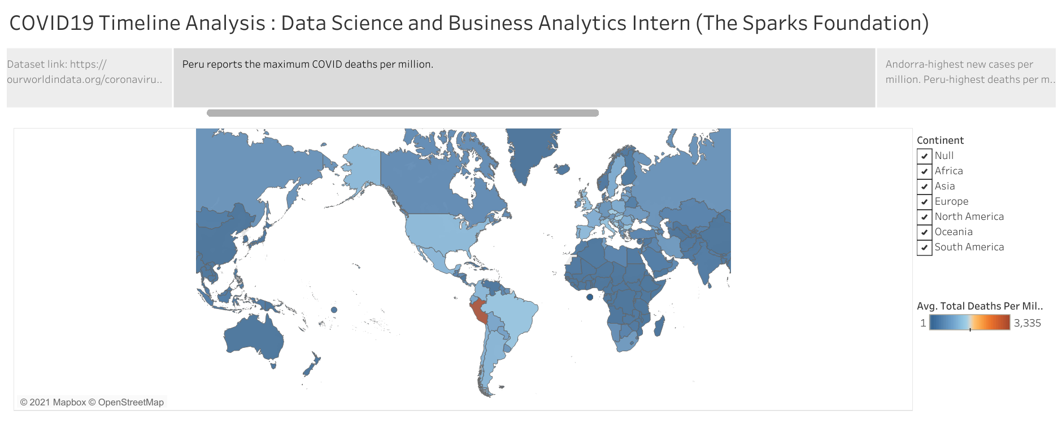

Slide 4
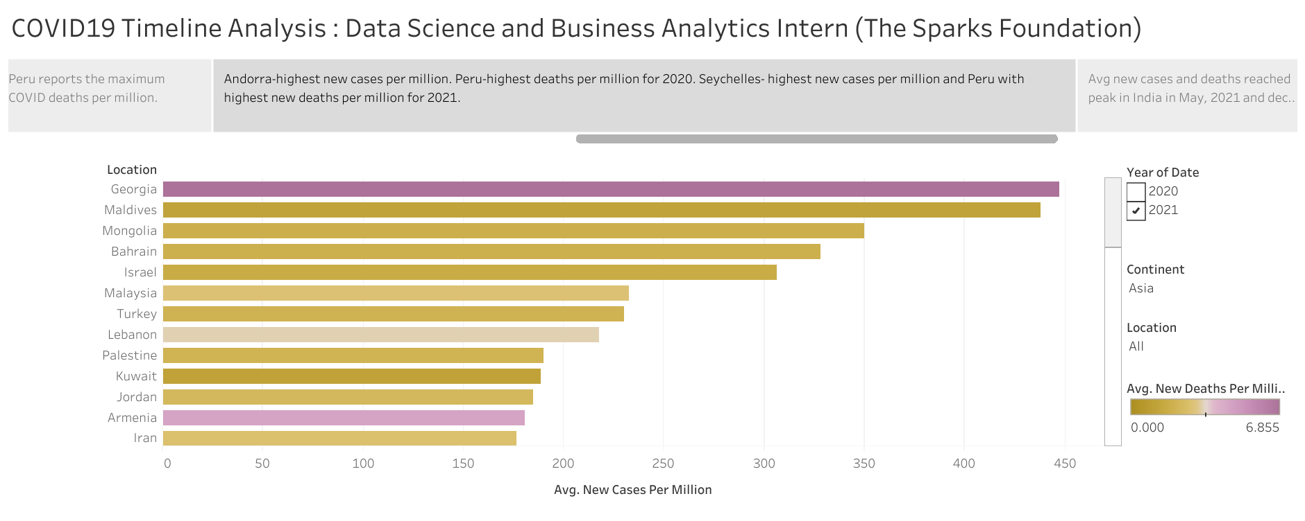

Slide 5
